Slide 1
Talent Acquisition
Training on iPeople enhancements and new functionalities
March 2024

Slide 2
Status of TA enhancements and new functionalities in iPeople
Item | Status - Date of availability
Candidate and Manager satisfaction questionnaires | LIVE - December 2023
New external career site on Workday | LIVE - December 2023
Apply with LinkedIn & Candidate data export from LinkedIn | LIVE - December 2023
Candidate pools | LIVE - January 2024
Recruiting sources & Auto-tracking | LIVE - January 2024 → + pending PSL
Improved candidate data purge request | LIVE - January 2024 → + pending Ticketing process
Simplified job requisition approval workflow | LIVE – February 2024
Evergreen requisition | LIVE – March 2024
Recruitment Launch Meeting form (=RLM) & Screening form | In Progress – Expected March/April 2024
Impact of Paradox on Job Application process in iPeople | // Paradox implementation
Interview notes & Feedback rating | Functionalities available – pending decision
Disposition codes + translation of the notifications | Content under review – pending decision
Confidential job requisition | Configuration to be reviewed

Slide 3
New external career site on Workday

Slide 4
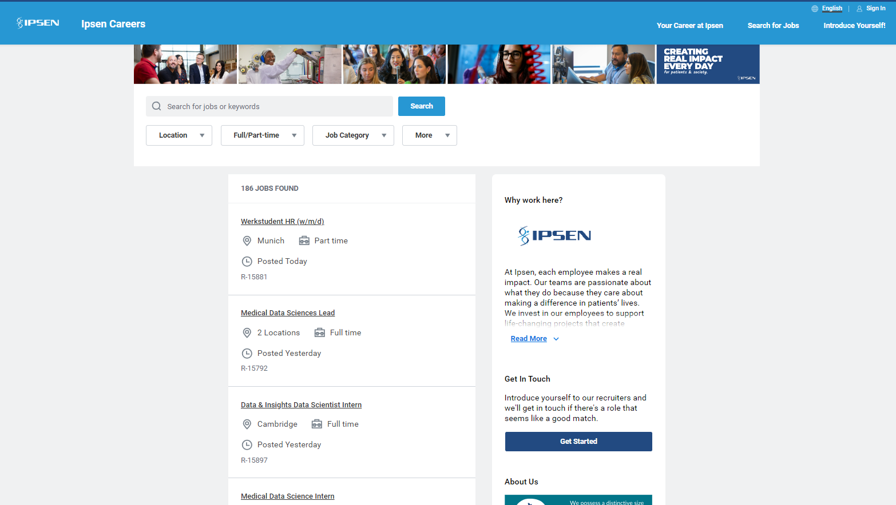
To the Ipsen Corporate website
Notes:
Available in English & French

Slide 5
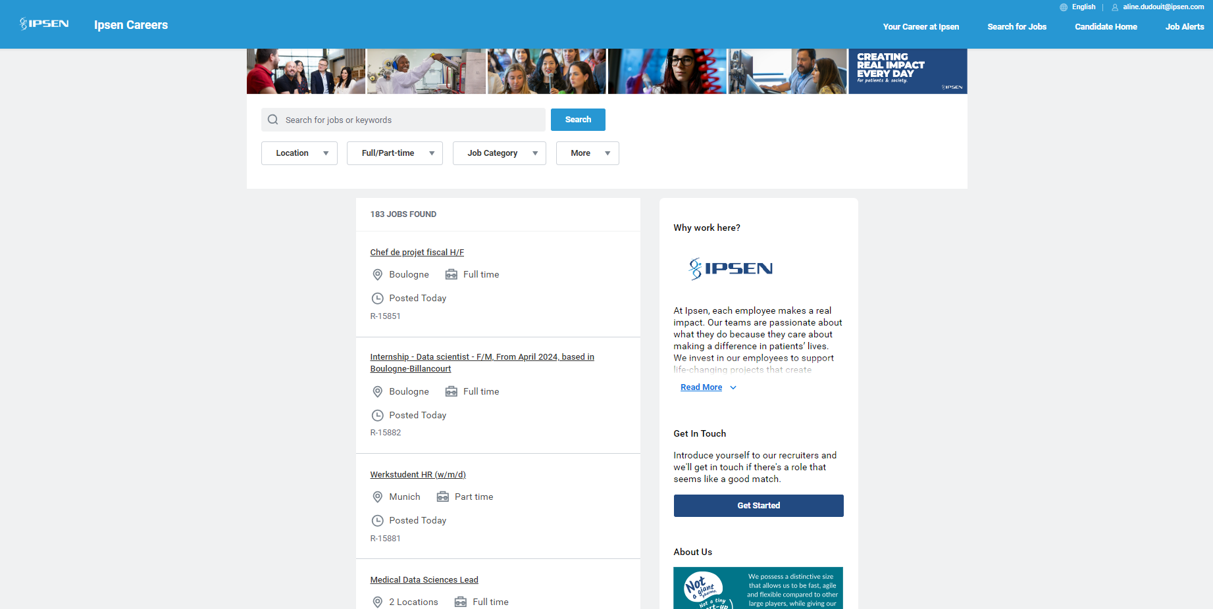
When the candidate is logged in
Notes:
Available in English & French

Slide 6
What’s new?
Immediate external job posting
Integrations with LinkedIn, Indeed, Glassdoor and Job Teaser
Enhanced experience for the creation of the applicant account, « Apply with LinkedIn »
« Introduce Yourself » pool to enrich Ipsen Talent Community
Embedded company culture including during the application process

Slide 7
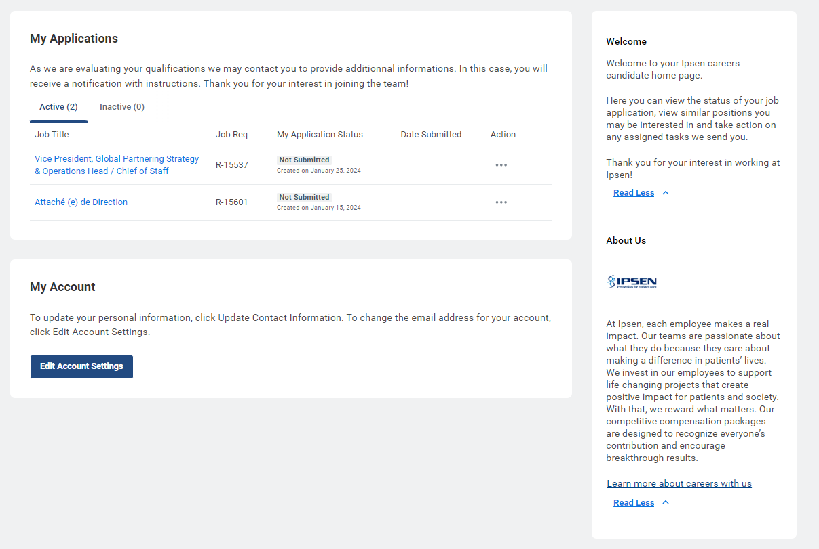
Candidate home – Application status
Candidates can see the status of their application in the candidate home

Slide 8
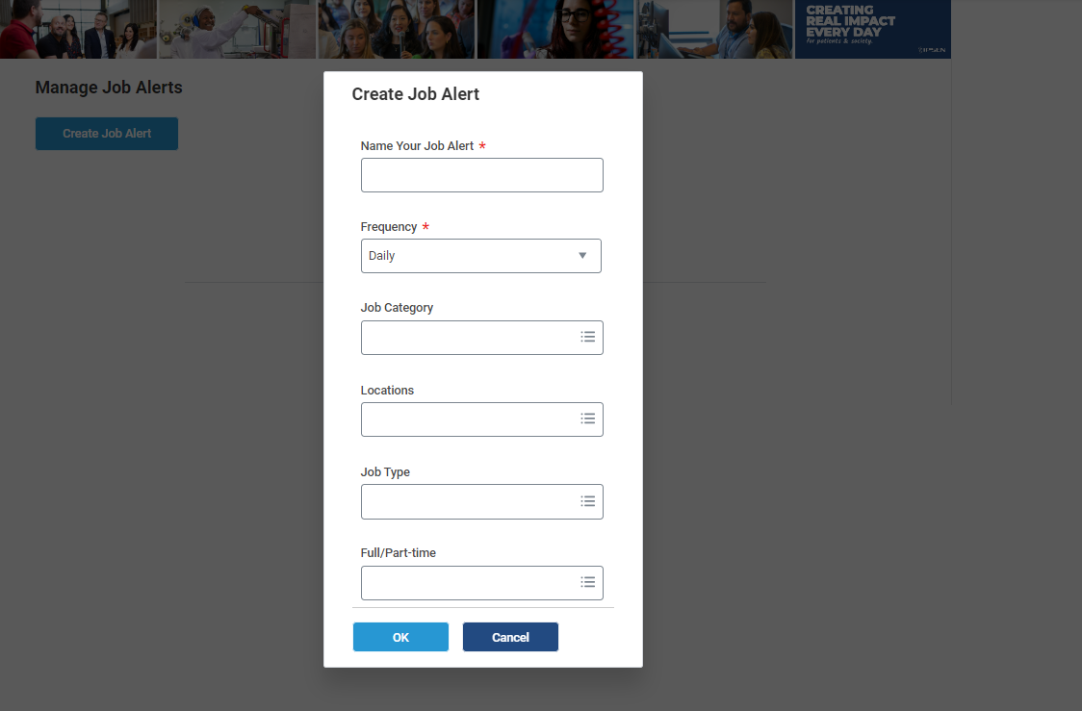
Candidate home – Job Alerts
Candidates can set up job alerts combining criteria:
Job categories, locations, job types, full/part time.
They can choose to receive daily or weekly alerts.

Slide 9
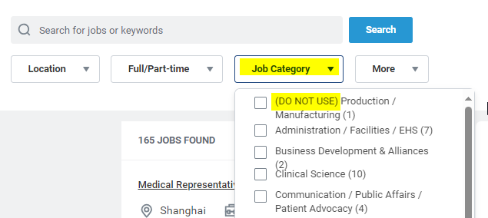
Help us ensure a great candidate experience
The use of old job catalog values are visible on the career site

Slide 10
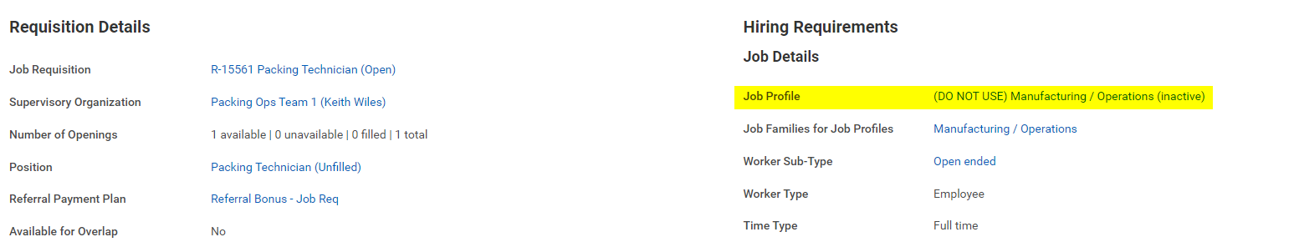
Help us ensure a great candidate experience
Job Profiles can be changed in the Job Requisition
The recruiting start date should be after January 5th, 2024, to access to the new job catalog values in the job requisition.

Slide 11
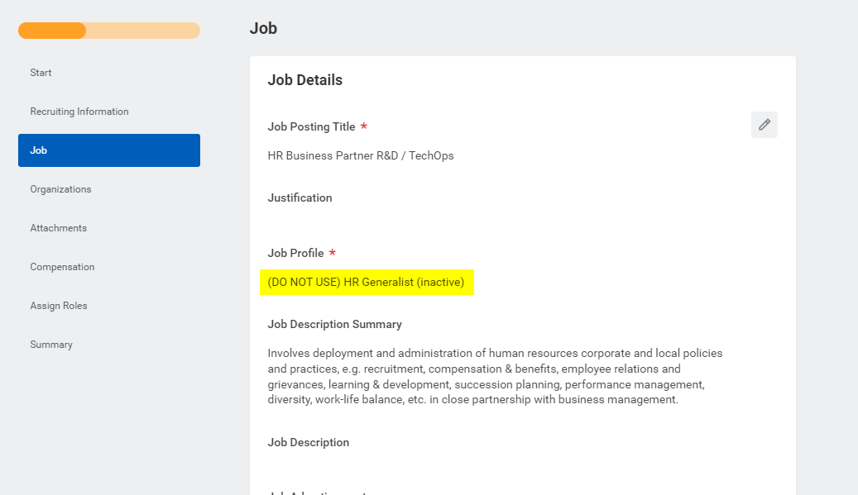
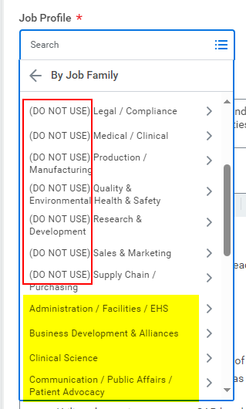
Help us ensure a great candidate experience
Job Profiles can be changed in the Job Requisition
Recruiting start date is driving the content of the job catalog

Slide 12
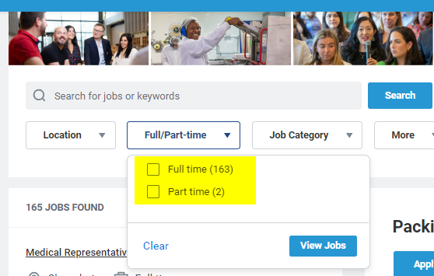
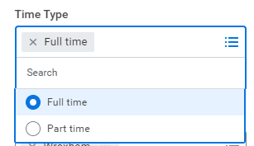
Help us ensure a great candidate experience
Select the Time Type in the Job Requisition to support the candidate search

Slide 13
Apply with LinkedIn
& Candidate data export from LinkedIn

Slide 14
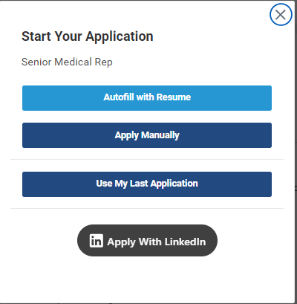
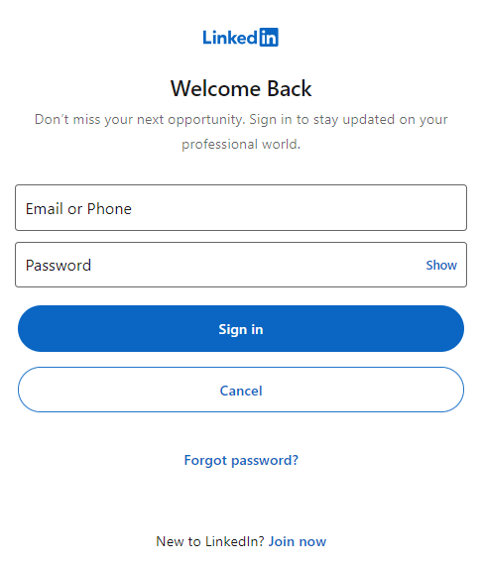
Apply with LinkedIn
Easy candidate application on the new external career site with resume parsing
The candidate account is automatically filled from his/her LinkedIn profile, accelerating the application process

Slide 15
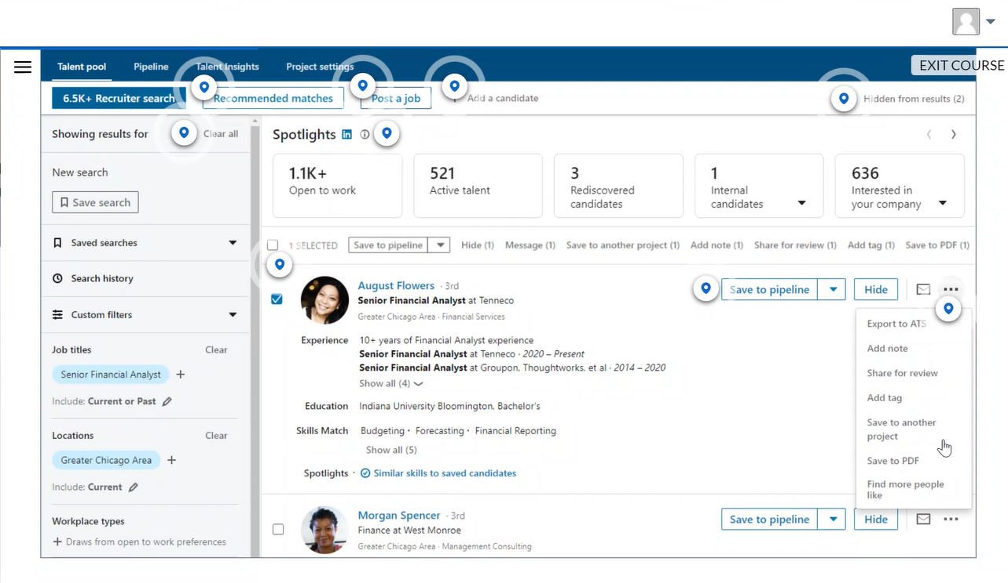
Integration with LinkedIn
Candidate can be transferred from LinkedIn to iPeople on a job requisition

Slide 16
Candidate pools

Slide 17
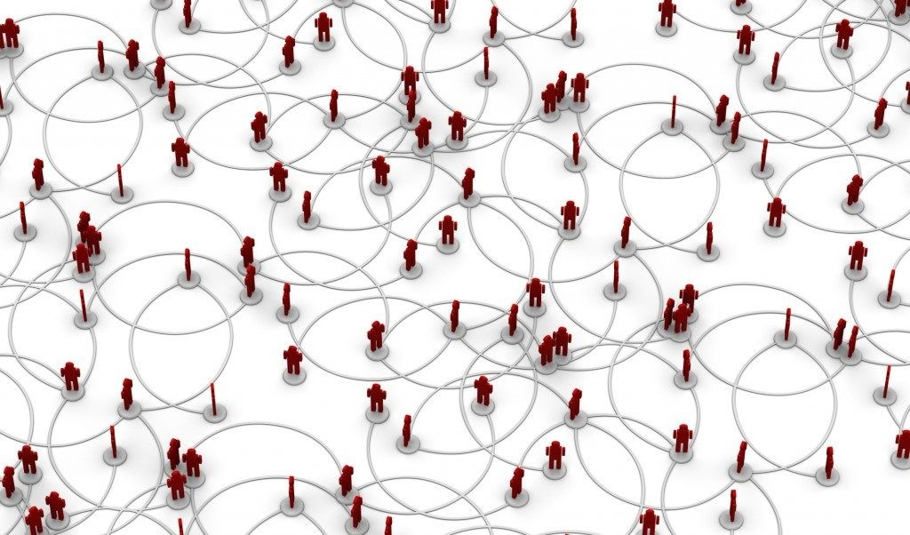

Candidate pools - Definition and use cases
Ability to group candidates according to criteria, in restricted or private pools, static or dynamic.
Candidate pools are used to:
Send messages to prospects
Invite to apply for additional jobs
Keep for future pipeline
NOTE
Create as many candidate pools as you need
Candidates can belong to multiple candidate pools

Slide 18
Candidate pools - Definition and use cases
Dynamic pools will be continuously updated according to criteria, whereas Static pool will be manually updated
Dynamic pool
Static pool
Create with specific criteria
Automatically and continuously adds
Candidates that match your criteria
Up to 50,000 members
Ex: continuous search for candidates with IT experience and a Bachelor’s degree.
Manually add members
Up to 25,000 members
Ex: targeted executive candidates to retain for future openings.
NOTE
Once you create a pool, you can’t change its type.

Slide 19





Candidate pools - Definition and use cases
Restricted pools are shared pools based on the iPeople security access (role & scope) whereas Private pools restrict access to the owner of the pool
Restricted pool
Private
Recruiter 1
Access to Org 1, 2, 3
Recruiter 2
Access to Org 3
Recruiter 1
Access to Org 1, 2, 3 Created Private Pool
Recruiter 2 Access to Org 3
Not granted access to pool.
Sees all
Sees only 1
X
No access to see pool or any details.
Sees all
Applicant in Org 1
Applicant in
Org 2
Applicant in Org 3
Applicant in Org 1
Applicant in
Org 2
Applicant in Org 3

Slide 20
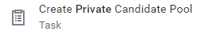
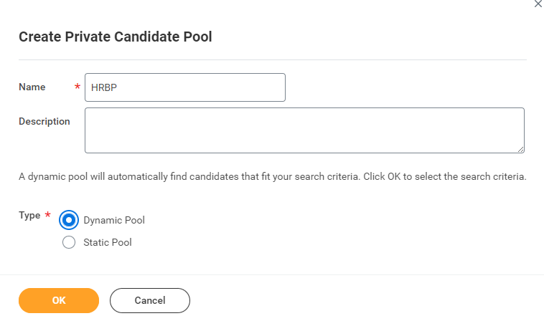
Candidate pools - How to create a Private Candidate Pool?
In the iPeople search bar, type and select « Create Private Candidate Pool »
Enter the name of the candidate pool: we recommend you to include in the name the job profile and/or the main criteria (location, expertise…). Select if you prefer a dynamic (continuously updated) or static pool (manually updated) and click on OK.
NOTE
Create as many candidate pools as you need
Candidates can belong to multiple candidate pools

Slide 21
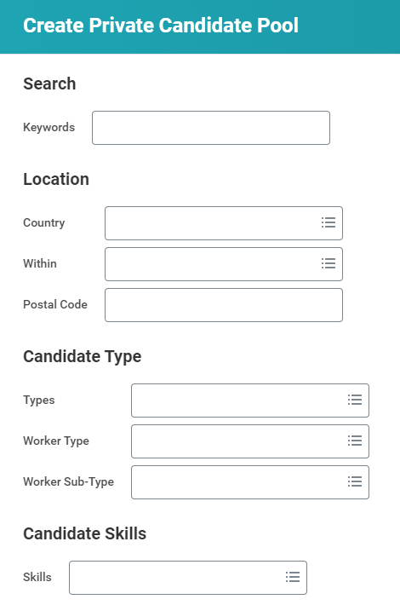
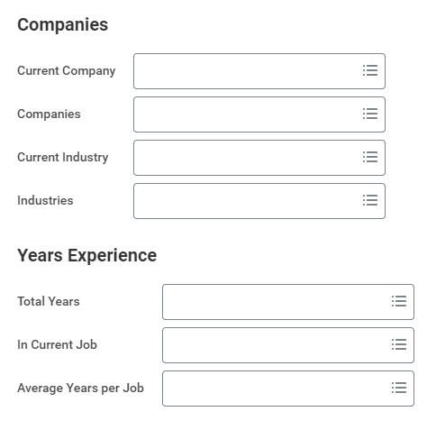
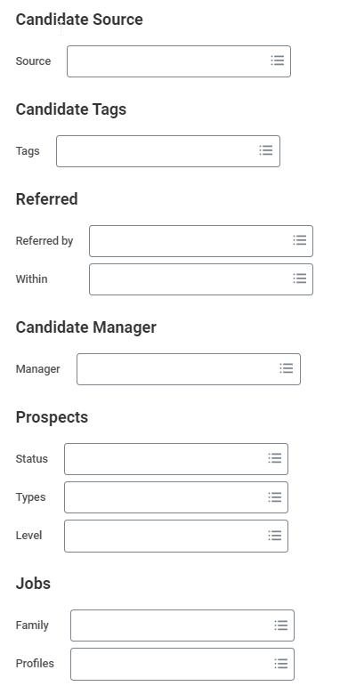
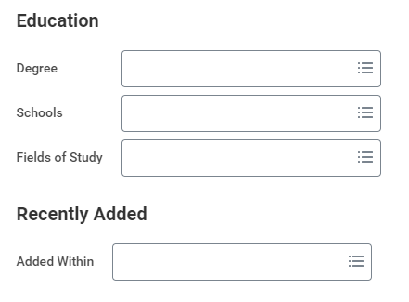

Candidate pools - How to create a Private Candidate Pool?
3. Enter criteria corresponding to your seach. Use the Keywords to directly search on resumes. Click on OK.

Slide 22
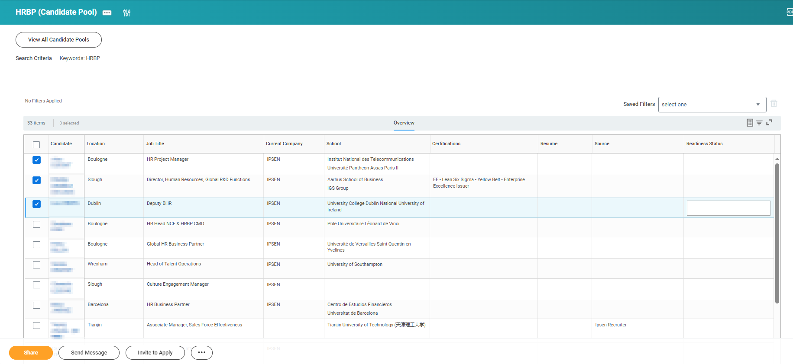
Candidate pools - How to access a candidate pool and take actions on candidates?
3. Select the candidate you would like to take action on:
  Click on Share if you want to send the candidate profile to another recruiter/hiring manager
  Click on Send Message if you want to contact the prospect or Invite him/her to apply
  Click on the 3 dots to Compare selected candidates
  Click on the 3 dots to include selected candidates in other candidate and/or talent pools

Slide 23

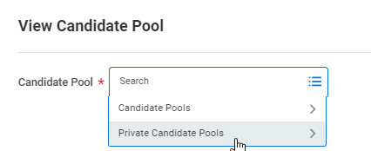
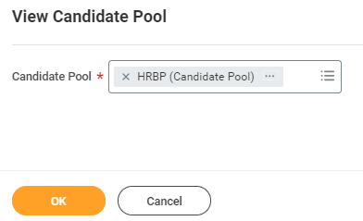
Candidate pools - How to access a candidate pool and take actions on candidates?
In the iPeople search bar, type and select « View Candidate Pool »
In the Candidate pool list, select the name of the pool you want to see. Click on OK.

Slide 24
Candidate pools - Include candidates or propects in Static pool
Find Candidates or Find Workers
  Select 1 - 5,000 candidates and Add to Pool
  Search criteria is “and”
View Candidate Pools
  Select 1 – 5,000 candidates
  Click More > Add to Pool
View Job Requisition > Candidates tab
  Select 1 – 5,000 candidates
  Click More > Add to Pool
Candidate Job Applications Report
  Select 1 – 5,000 candidates and Add to Pool
Candidate Profile
  Click tag icon and select 1 or more candidate pools from the Tag to Pools: prompt
  Related Actions: Candidate Actions > Add
to Pool
Worker Profile
  Click tag icon and select 1 or more candidate pools from the Tag to Pools: prompt
Prospect or Candidate Profile (Mobile)
  Related actions menu > Add to Pool

Slide 25
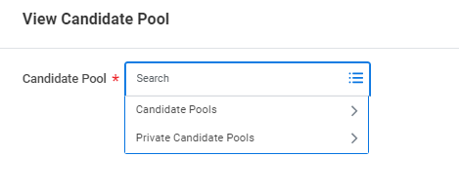
Candidate pools – Summary of available actions
Restricted pool | Private pool
Create Candidate Pool | Create Private Candidate Pool
Edit Candidate Pool | Edit Private Candidate Pool
View All Candidate Pools
View Candidate Pool

Slide 26

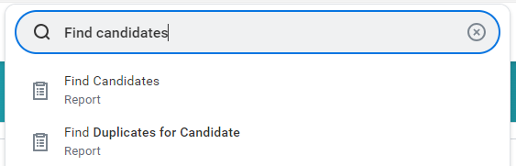
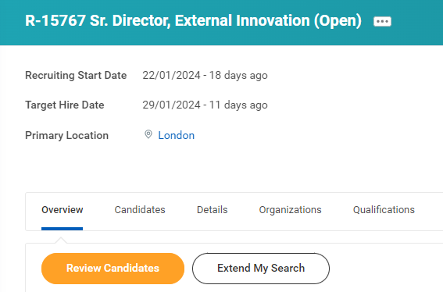
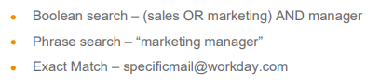
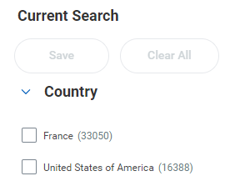
Searching for Candidates without creating a Candidate Pool
If you wish to simply search our database of ~120,000 candidates instead of creating a candidate pool, you can;
Type ‘Find Candidates’ in the iPeople search bar >
Or you can;
Visit your job requisition and select « Extend My Search »
Use the search bar to search for key terms including in the following methods >
Or use the Filter Criteria down the left hand of the screen:

Slide 27
Improved candidate data purge request

Slide 28
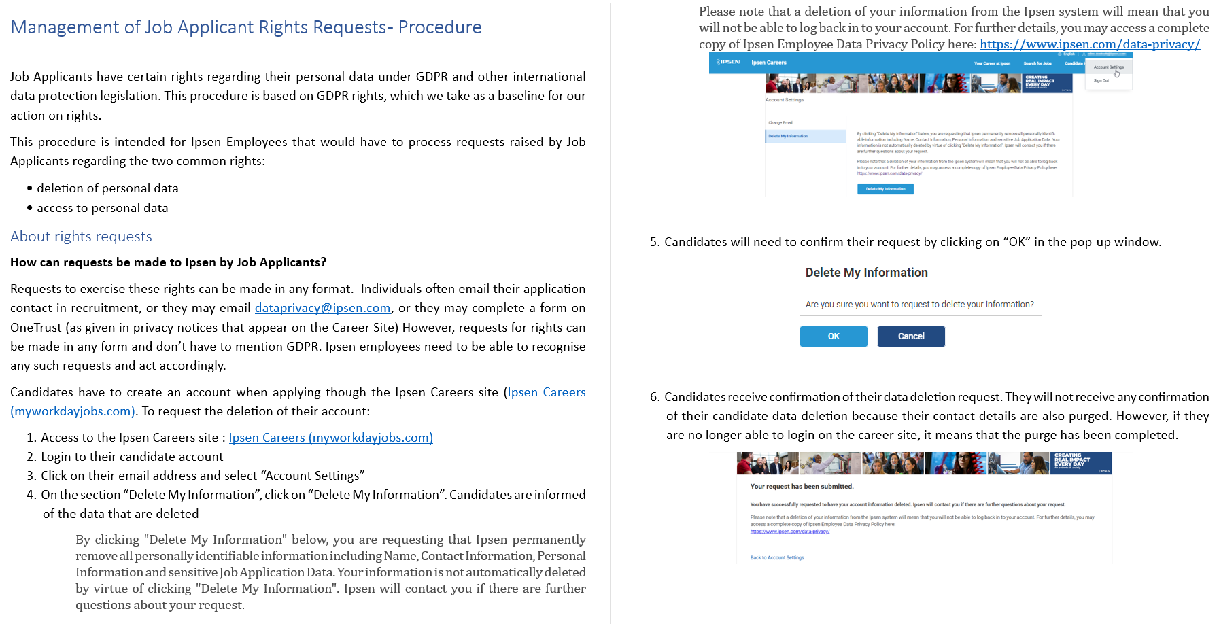
Candidate data purge request

Slide 29
Candidate data purge request - Process
1. HRIS:
  Receive the request.
  Create a ticket in ServiceNow using the category “Candidate data purge”*
  If any doubt about the requesters’ identity, go back to the contact details collected as part of the application process and contact the individual from those contacts, to check they are who they say they are.
  Identify the TA person responsible (primary recruiter, head of TA hub…)
  Make a note of the date by which the action of response is needed.
  if not already alerted, inform the Privacy Office of the request by emailing dataprivacy@ipsen.com
  Send a standard email to the identified TA person
  Reply to the individual saying that you have received their request and will be actioning it (acknowledgement receipt)
2. TA person responsible:
  Make a list of all documents that need to be deleted and of the people that have access to these data. Send them a request for deletion and confirm with each person that they have done so.
  Confirm to HRIS that all data have been deleted.
3. HRIS:
  Delete data held in Corporate systems (iPeople….)
  Request confirmation for the TA responsible that actions have been completed in due time.
*The tracking of data purge request remains unchanged until the category « candidate data purge » is available in ticketing system

Slide 30
Evergreen requisition

Slide 31
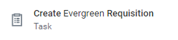
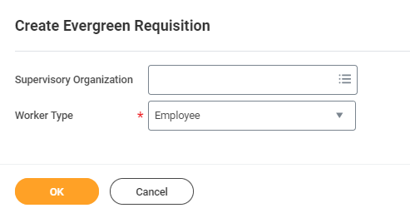
Evergreen requisition
Evergreen requisitions allow you to continually source and track candidates for pivotal roles, hard-to-fill positions, high-turnover or high-volume. It helps maintain a pool of skilled candidates for positions that are difficult to fill. You can source candidates for positions when you don't have all the details yet, or source candidates in external events.
In the iPeople search bar, type and select « Create Evergreen Requisition »
Select the supervisory organization where you would like to create the evergreen, keep the Employee worker type.

Slide 32
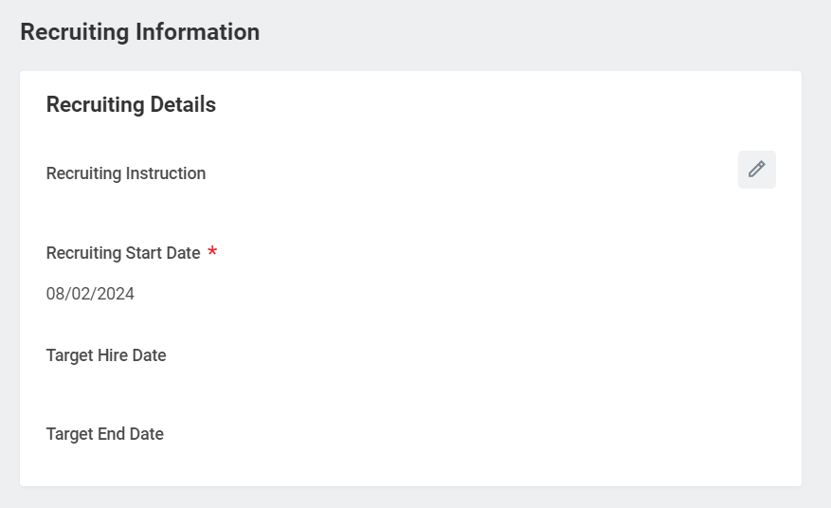
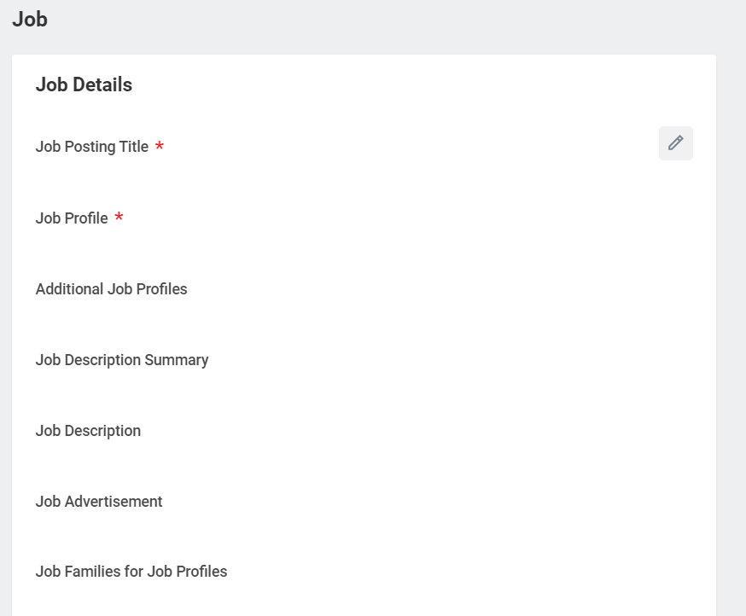

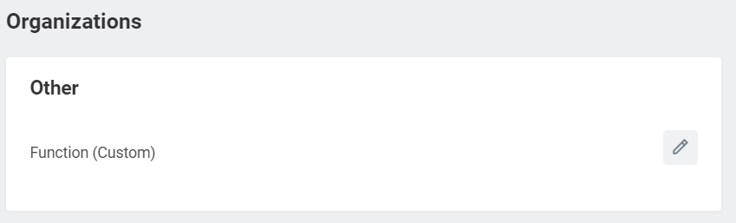
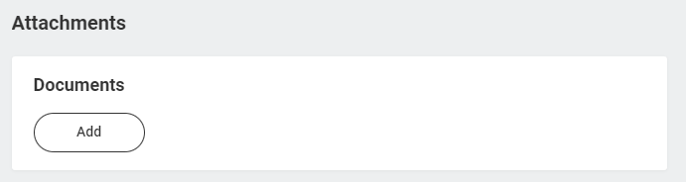
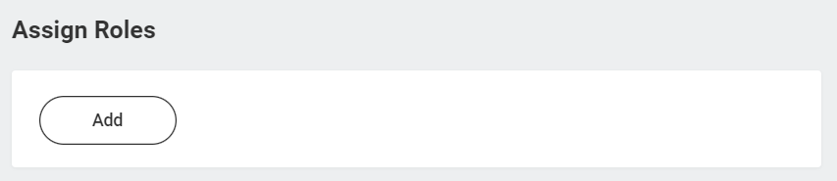
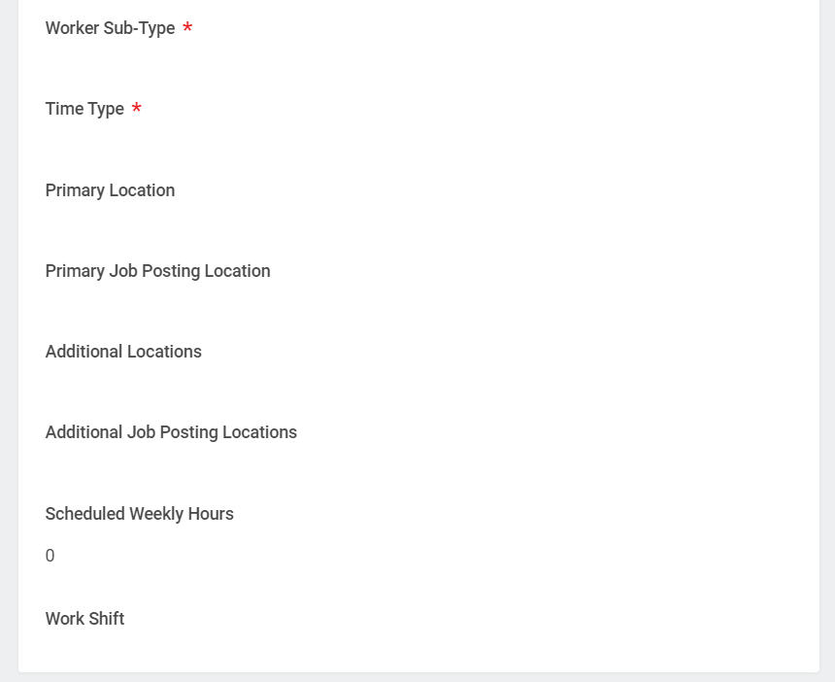
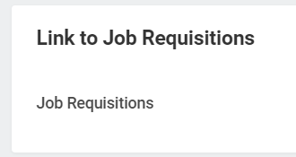
Evergreen requisition
Fill in the information related to the evergreen requisition and assign at least one primary recruiter:
Company and cost center
Justification
Attachment not mandatory

Slide 33
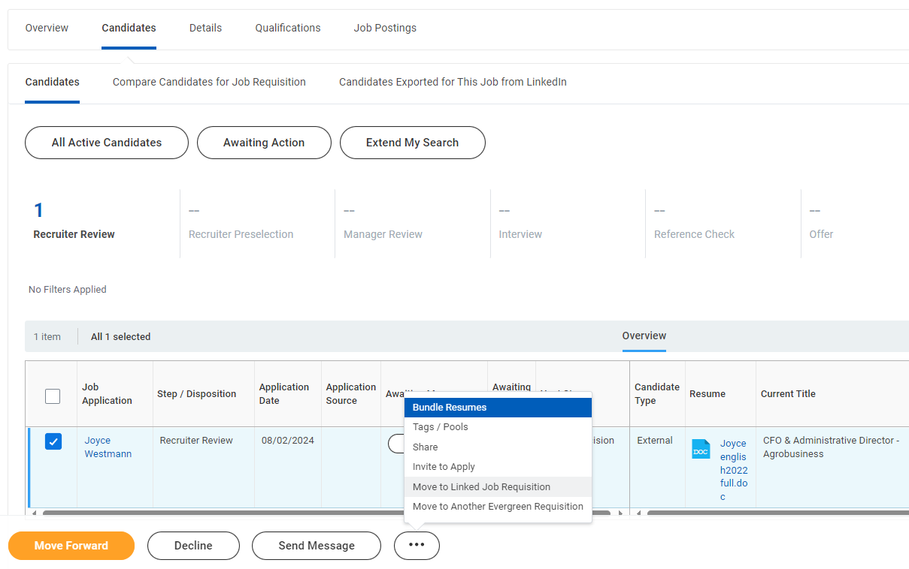
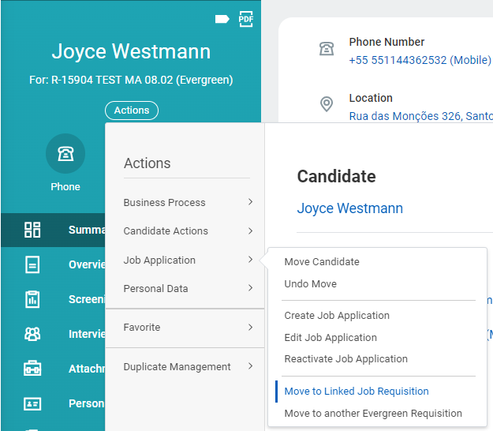
Evergreen requisition
To hire a candidate from an Evergreen requisition, you will need to move candidate to a regular job requisition. You can move a candidate from Evergreen requisition to a Job Requisition only if:
- The Evergreen and Job Requisition have the same Job Profile
- The link to the Job Requisition or to the Evergreen has been indicated in the Evergreen or the Job Requisition
From the Evergreen:
From the Candidate Profile:

Slide 34
Evergreen requisition
The Business Processes are initiated and completed by Recruiters by the following actions:
Create Evergreen Requisition
Edit Evergreen Requisition
Close Evergreen Requisition.
All recruiters can see and edit all evergreen requisitions using « View Evergreen Requisition ».
The link between and evergreen requisition and a job requisition can be edited any time using the « Edit evergreen requisition » task.
Make sure to unpost and repost the evergreen regularly to refresh the job advertisement and posting date on jobboards.

Slide 35
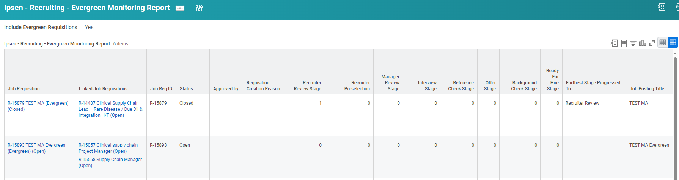
Evergreen requisition
The Evergreen requisitions are available in the iPeople report:

Slide 36
Recruiting sources & Auto-tracking

Slide 37
Optimized recruiting sources referential
Recruiting Source Category | Source
Contractor Conversion | Contractor Conversion
Corporate Website | Corporate Website
External Event | External Event
Internal | Internal
Ipsen Recruiter | Ipsen Recruiter
Job Board | Indeed / Glassdoor
 | JobTeaser
 | LinkedIn
 | Other Job Board
Recruiting Agency | Pending PSL review
Referral | Employee Referral
The list of Recruiting agencies will be updated with the outcomes of the PSL review.

Slide 38
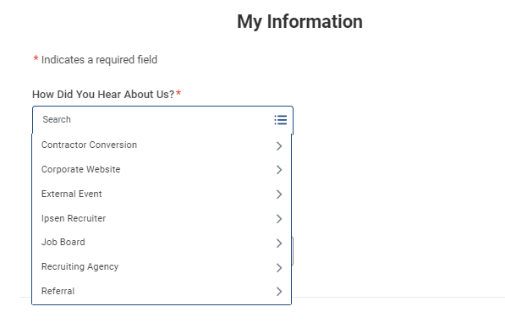
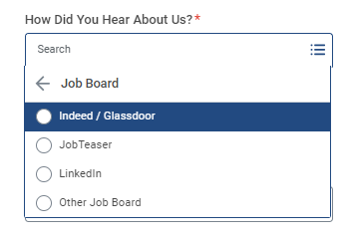
Recruiting sources
Candidate view on the external career site
Sources are now grouped by category to improve the candidate experience.
Autotracking is available for the job boards LinkedIn, Indeed / Glassdoor and JobTeaser.

Slide 39
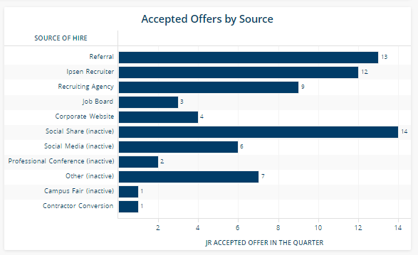
Source of Hires available in HR Insights
Talent Acquisition Job Req – Accepted JR
Inactive sources still appear because job requisitions with candidates coming from inactivated sources are hired on job requisitions

Slide 40
Any question on iPeople?

Slide 41
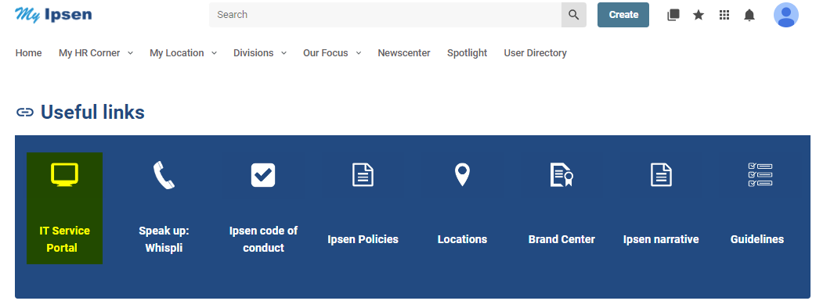
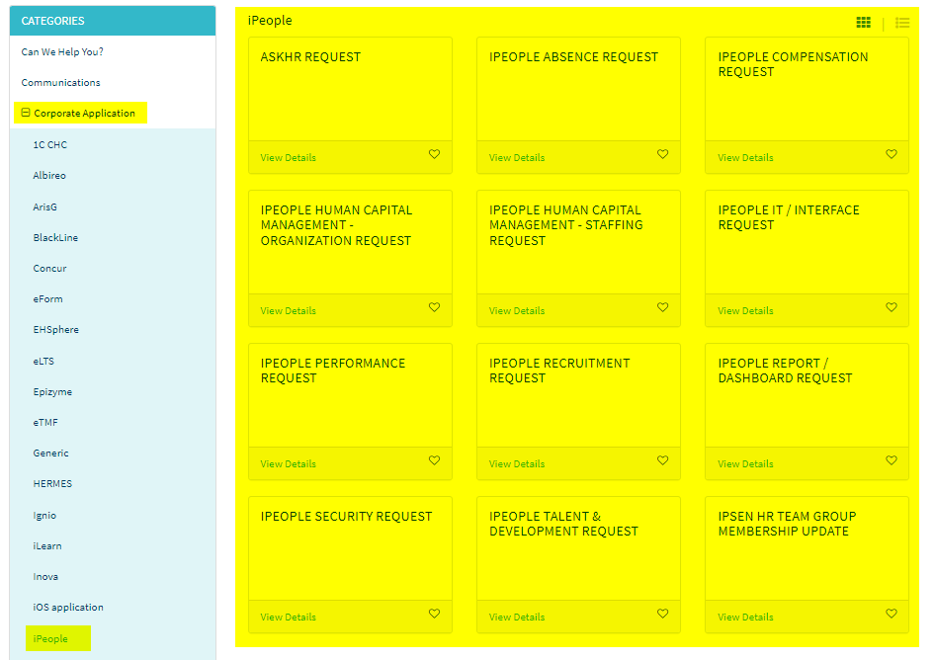
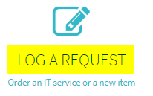
Need support on iPeople?
1
4
Under Categories, click on iPeople under Corporate Application. Select on the right the type of request you want to send.
Access to the intranet
2
Scroll down to Useful Links and click on IT Service Portal
3
Click on Log a request

Slide 42
Thank you
Notes:
External closing slide

