Slide 1



Ipsen
Employee Referral Program

Slide 2


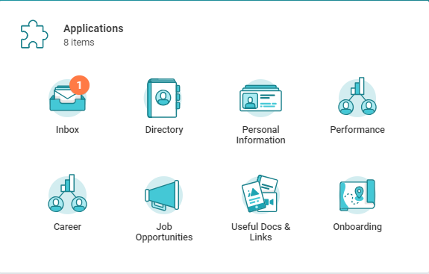
Refer a candidate for a job @ Ipsen
Receive a referral bonus for each successful candidate!
You will receive the bonus once the candidate has join the company.
1
On your Homepage, click on the Job Opportunities worklet and then click on Refer a Candidate
2
Complete the Referral Details.
Then, enter the Candidate’s Contact Information.
Select the job on which you want to refer a candidate.
Indicate you Relationship and Submit.
3
You referred candidate receives an Ipeople email asking him to apply to finalize the referral process.
4
Track your referrals in My Referrals.
Candidates can apply directly on careers.ipsen.com/

