Slide 1

Referral program update for HR
November 2022

Slide 2

Referral policy
Who can refer?
  Everyone, everywhere and for all kind of roles!
Must be submitted via iPeople
If a resume has been previously submitted by another source, the employee is not eligible to receive the referral bonus.
Bonus for vacant regular full-time or part-time positions only
Paid at the candidate’s start date
Population not eligible to the bonus:
  Consultants/Contractors,
  HR population
  VPs and above
  Immediate supervisors/hiring managers of the position + employees who are directly involved in the interview process for the open position
  Ipsen employee in trial or notice period

Slide 3
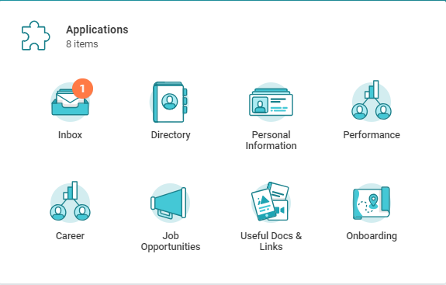
How to refer a candidate for a job @ Ipsen
Receive a referral bonus for each successful candidate!
The bonus will be validated the first day the candidate joins the company.
1
On your Ipeople Homepage, click on the Job Opportunities icon and then click on Refer a Candidate
2
Complete the Referral Details.
Then, enter the Candidate’s Contact Information.
Select the job for which you would like to refer a candidate.
Indicate your Relationship and Submit.
3
Your referred candidate receives an automated email from Ipeople asking them to apply to finalize the referral process.
4
Track your referrals in My Referrals.
Candidates can apply directly on careers.ipsen.com/

Slide 4

Updated Ipeople validate process: How does it work?
COMPENSATION PARTNER
HR ADMIN
SITE HR
PRIMARY RECRUITER
(TA or HR)
Hire task
One time payment for referral task
Submit
Approve
Skip
Process Denied
Is Notified
Process completed
Can Correct
Can Rescind

Slide 5
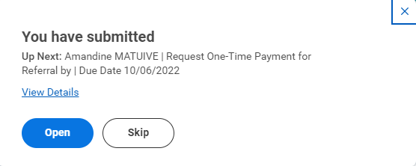
One Time Payment for Referral – Recruiter #1
Task assigned to the Primary Recruiter following the approval of the Hire process by the Site HR. This task can be completed or skipped by the Primary Recruiter

Slide 6
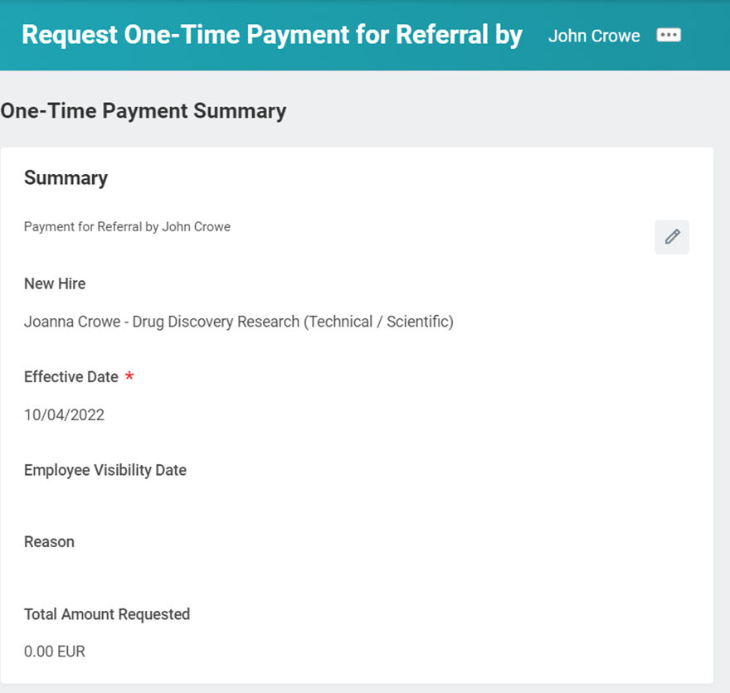
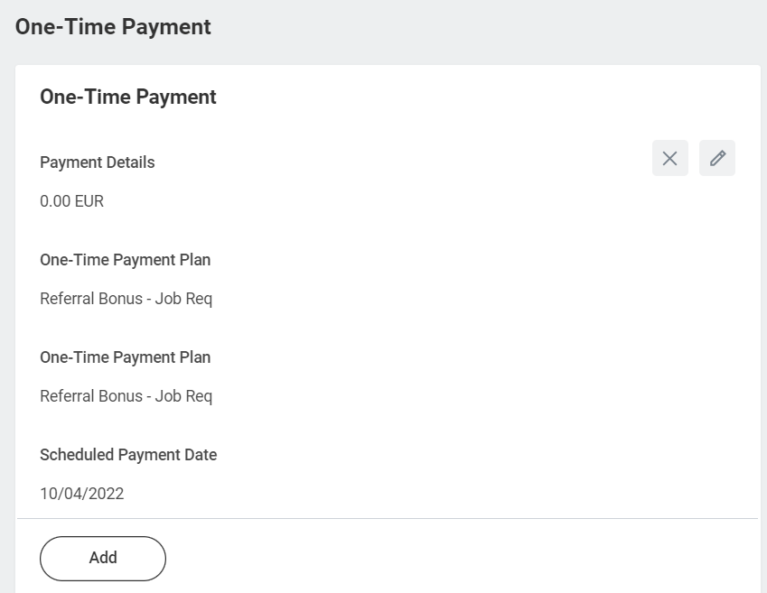
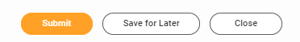
One Time Payment for Referral – Recruiter #1
The Primary Recruiter can update each field

Slide 7
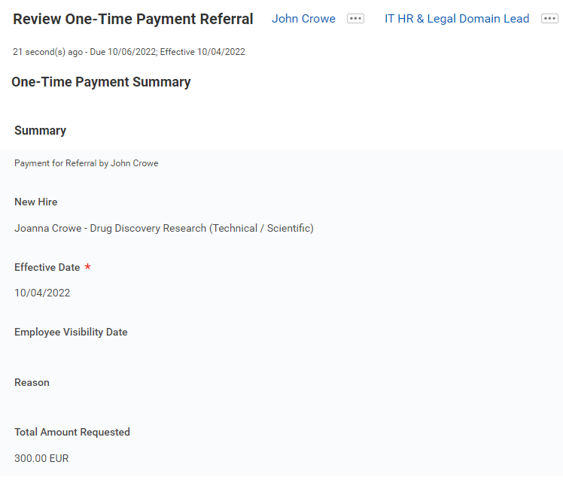
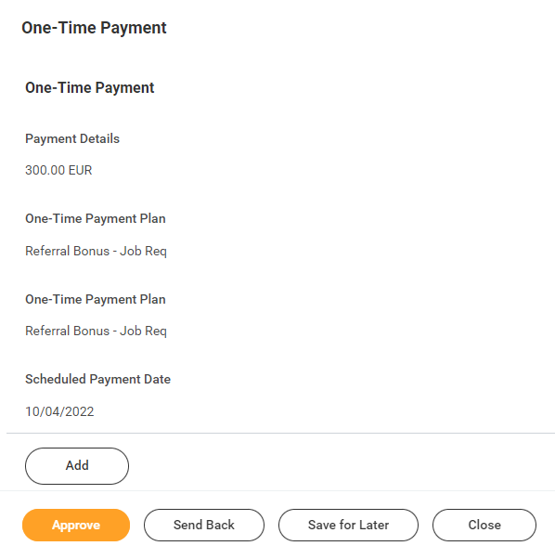
One Time Payment for Referral – HR Admin #2
Task assigned to the HR Admin following the task submission by the Primary Recruiter. The HR Admin can approve or send back this task.

Slide 8

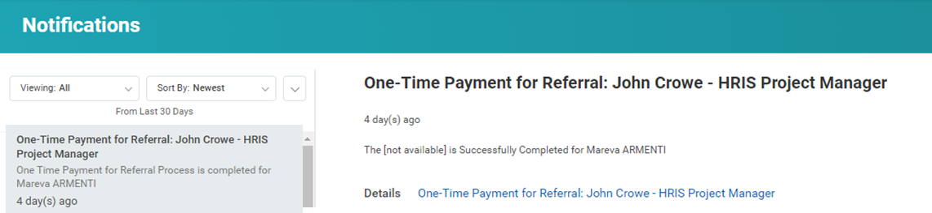
One Time Payment for Referral – Site HR #3
The Site HR is notified following the process approval by the Site HR

