Slide 1
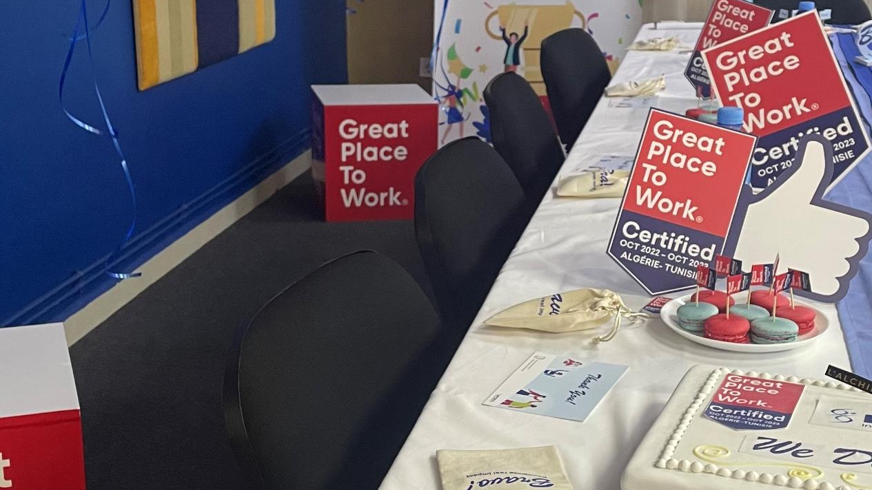
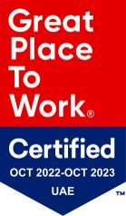


MEAM Certified Great Place to Work
2022-2023
We are incredibly proud and delighted to share the news that our organization is officially recognized as Great Place to Work-Certified™ for the whole MEAM region in Algeria, Tunisia & UAE.
Thank YOU for making us a Certified™ GREAT workplace!
Congratulations to all the teams who have demonstrated their unfailing commitment, their great motivation and agility to contribute relentlessly to our primary mission: improving the lives of patients. Let's continue to build on this momentum to make our company a place where it's good to live and work together, in a positive and constructive culture. Counting on all of you; to go all together towards more beautiful consecrations.
Being Certified™ gives us vital insight into which programs and policies you appreciate, as well as data on areas where we can improve. Thanks to your participation in the survey, we now have invaluable employee comments and rich metrics that will help us to give you an even better employee experience moving forward.
Thank you again for the trust you place in us every day.

