Slide 1

Continuous Feedback
HR Talent Management & Engagement Update - March 22nd , 2021
Mirjana Le Friec

Slide 2
Importance of Continuous Feedback
HR role in continuous feedback
For Ipsen
For employees and managers
Action plan
Deployment plan
Communication plan
Main milestones
Feedback toolkit
Feedback at Ipsen
Feedback in HR processes
Availability of tools
Tools’ presentation

Slide 3
01
Continuous Feedback Importance

Slide 4
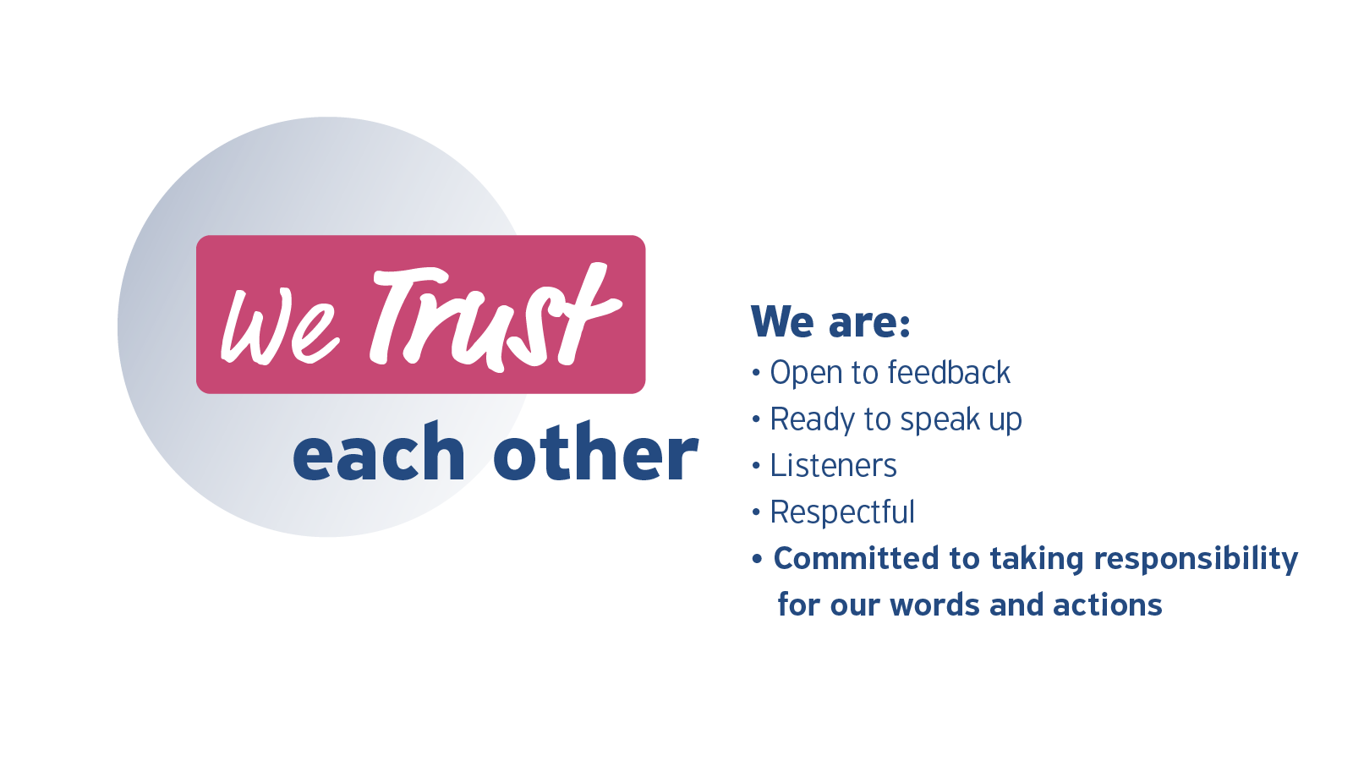
Culture of Continuous Feedback - Commitment
Feedback makes employees, managers & the company grow in a continuous improvement cycle
At Ipsen, continuous feedback and speak up culture is embedded in our Ipsen Way of Being.
Open, honest and candid dialogue is core to our work and how we act with others.
We provide candid and constructive feedback as well as we ask for it. We promote and seek honesty and transparency at all we do.

Slide 5
Culture of Continuous Feedback
Feedback: at every step of employee journey
Attracting
Onboarding
Engaging
Retaining
Legacy
Selecting
Ipsen Way of Being
Employer brand
Current or former employees’ feedback
Assessment
Interview
Satisfaction survey
Onboarding feedbacks
Training assessment
Development feedback
Performance feedback
Engagement survey
Employee recognition
Pulse survey
360 feedback
Assessments
Coaching
Mentoring
Exit survey
Referral feedbacks (on- & off-line)
Alumni feedbacks

Slide 6
What are the benefits of a Feedback culture?
For Employees , Managers and Ipsen
Employee empowerment
Giving employees a voice is to hear them, to let them share their ideas and concerns, and to ultimately create a feeling of recognition and appreciation. This, in turn, increases their proactivity and innovation and decreases frustration and ultimately turnover.
We learn & share: a continuous improvement
By establishing regular and frequent feedback exchanges, employees develop a growth mindset. Frequent feedback sessions aim at identifying the potential for improvement on a number of levels and create the basis for growth. When given sincerely, feedback helps us to understand where or what we need to change.
Accountability
When we are required to give feedback, especially constructive, we become accountable for what we say.
Create a safe environment and speak up culture
When feedback is given and accepted, it fosters a relationship of trust.
A feedback culture can help improve open communication with employees. When a company focuses on being open and honest with itself, it’s easier to communicate corporate objectives, goals, and areas of focus/improvement.

Slide 7
02
Feedback and
Ipsen

Slide 8


At Ipsen, we encourage 4 types of feedback
Now we make continuous feedback reality, shifting from philosophy to strategy of implementing culture of Feedback
Individual action with collective impact
Individual action with impact on performance and development
Employee survey Feedback
Employee/Manager Feedback
We leverage global and local feedback when employees participate in Engagement survey but also in more specific internal poll survey or participate in the Great Place to work survey!
Inside our HR processes, feedback is an essential part of continuous improvement between managers and employees and with key stakeholders. Our aim is to improve our tools to make feedback a routine.
Employee review Feedback
Employee peer-to-peer Feedback
We listen carefully when our employees are giving us feedback also on external platforms such as Social media and more specifically Glassdoor/Indeed websites.
It is key to receive and give feedback regularly to better put things in perspective and better collaborate with each other.

Slide 9






Continuous Feedback all along the year
2021: Feedback in HR processes
Jan
Feb
March
April
May
June
July
Aug
Sept
Oct
Nov
Dec
iPerform
Objectives
Set
Update objectives
pre-calibration
ELT Calib
Performance Review
Feedback feed objectives & their updates
y/e review
Continuous Feedback
Feedback feed
performance review
Feedback
Feedback feed potential assessment
Feedback feed development plan
Ipsen Engagement survey
360°
Pulse
iDevelop
April 1st to July 1st
Follow-up & update
Talent Review
Follow-up
Talent Review
Assess Potential
April 1st to 26th
Country/Division Calibration
April 26th to June 11th
ELT
June 24th
April 1st to July 16th
Development Plan
Work on Action Plans
Development Plan
Work on Action Plans

Slide 10
03
Your Role
as HR

Slide 11
Action Plan to deploy a continuous Feedback culture
Educate
Train employees and managers on giving, receiving and asking for feedback in an efficient way (iLearn, workshops, guides, videos…)
Promote feedback with employees as a daily routine to grow (icebreakers, bank of questions…)
Develop managers skills to act as coach (iLearn, discussions…)
Practice
Put Feedback at the center of daily activities (1:1, team & project meetings) and
leverage available tools (iPeople, surveys, 360°…)
Promote Feedback at each step of employee lifecycle
Encourage honest feedback between employees (P2P), btw employees / managers, and between managers /executives - both ways
Monitor
Monitor Feedback quantity via HR insights
Monitor Feedback quality via iPeople reports
Support development with 360 reports
Follow up on action plans after engagement or pulse surveys

Slide 12
Rollout plan
When and what to start deploying
What | When | Who
Adapt/translate materials (see section 04) | April - May | Hubs & Local HRs
Set up workshops to educate on Feedback | From end of April (materials ready) & all year long | Hubs & Local HRs
Promote feedback following HR processes calendar | Beg. of April 2021 & all year long | Global TM with iDevelop Hubs & Local HRs
Rollout of 360° feedback for GLT | Q2 (tbc) / Q3 | BHRs
Monitor feedback (quality, quantity): iPeople, HR insights | All year long | Hubs & Local HRs

Slide 13
Communication plan
Building awareness to make Feedback continuous
What | Target | When | Who
Communication on available materials | HR community | Mid April | Global TM
Communicate on materials available for your local population | Ipsen all employees | From mid April | Hubs & Local HRs
Ipsen Planet article | Ipsen all employees | End April/ May (tbc) | Global TM
Email templates linked to HR processes with mention of Feedback | Ipsen all employees | From April 1st & All year long | Created by Global TM Sent by Hubs & Local HRs
Leverage communication opportunities about feedback: Divisional town hall / Seminars / Team meetings / Leaders’ forum… | Ipsen targeted groups | All along the year | BHRs / Local HRs

Slide 14
Culture of Continuous Feedback – at a glance
WHY
Lead by example
Identify talents & high po
Set clear expectations (Nurture Positive and Corrective Feedback)
Promote internal mobility
Improve business performance and Grow our people
WHAT
CONTINUOUS FEEDBACK: IMPLEMENT A FEEDBACK CULTURE
Who gives feedback? / Who receives it? / How often does it occur? / How do we do it? / What is the goal of feedback?
HOW
Use different feedback channels
Attributed Anonymous 1:1 180° 360°
Individual Group Face to face Remote
Ensure a feedback safe environment
WHO
Executives
Senior Leaders
Leaders
Individual
Contributors
ELT members
as sponsors
Change mindset
Practice feedback: “Grow, Perform, Succeed”

Slide 15
04
Feedback
Toolkit

Slide 16


Which Feedback tool for which use cases?
Off the shelf tools available to promote a culture of continuous Feedback
All materials and how to guides will be available on a dedicated Box folder in April
Employee survey Feedback
Employee/Manager Feedback
Engagement platform for yearly survey
Pulse survey
Great / Best place to work surveys
Get Feedback on Self – iPeople
Get Feedback on Worker – iPeople
360° Feedback
1:1 ones: questions bank
Emails
Surveys (Forms*…)
Employee review Feedback
Employee peer-to-peer Feedback
Glassdoor / Indeed
Social media
Be*One: Ipsen recognition platform
Team meetings: icebreakers for F2F & virtual mode
Get Feedback on Self – iPeople
1:1 ones: questions banks
Emails
Ready
Coming soon
*anonymous or non anonymous

Slide 17

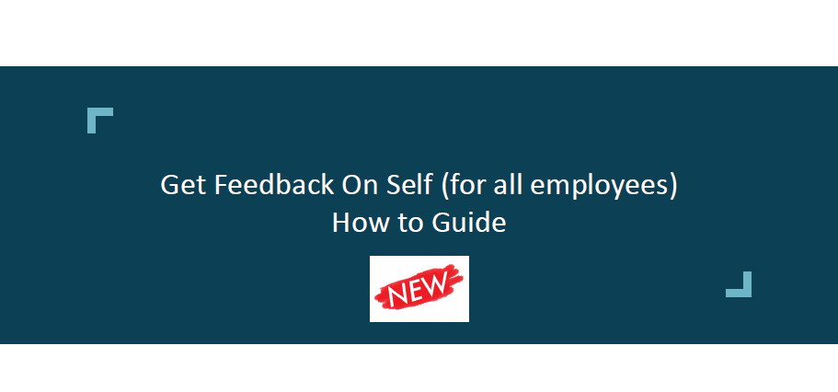
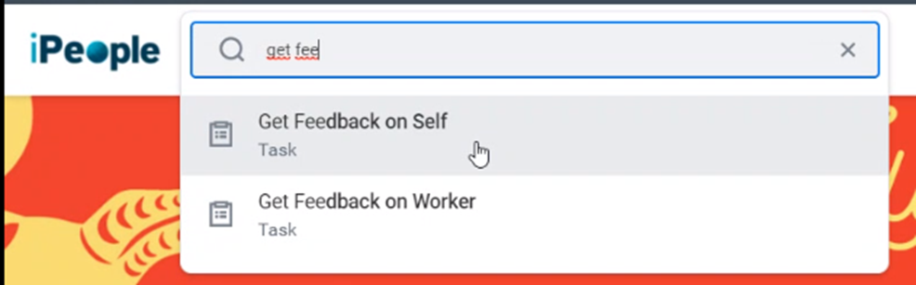

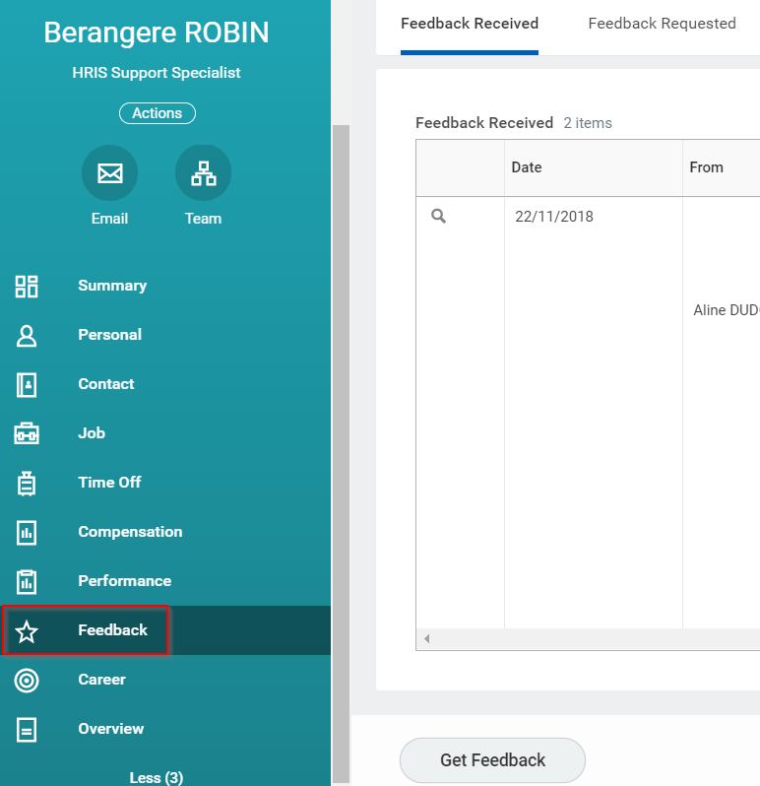
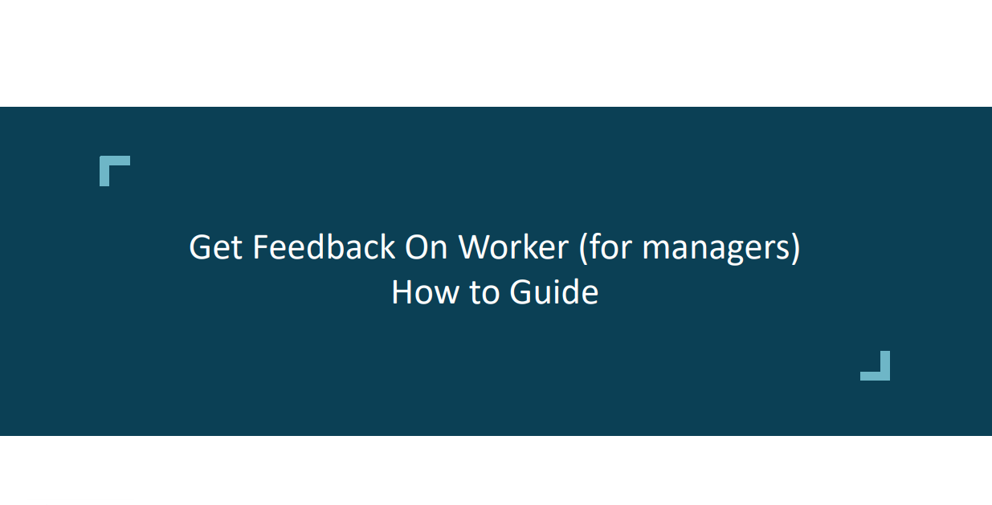
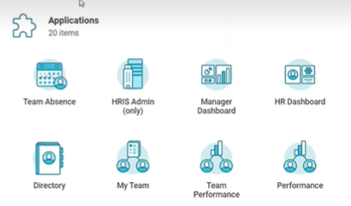
Feedback for all in iPeople
Make feedback continuous and not linked to iPerform only
Feedback available
for all
via iPeople search bar
Feedback available
for all
from Employee profile
Click to access
Feedback available for all
via Performance worklets:
Performance: for Feedback on self
Team Performance: For feedback on worker

Slide 18

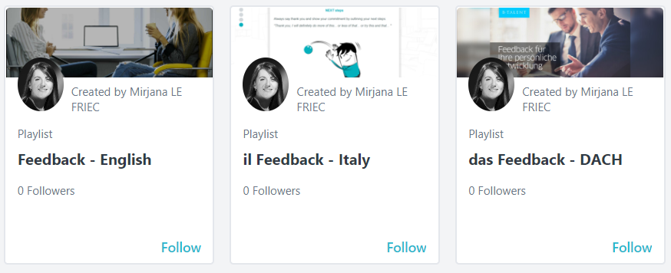
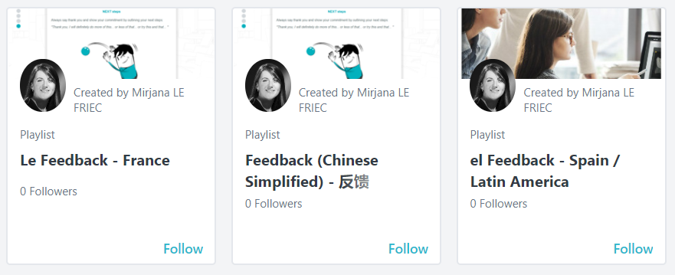
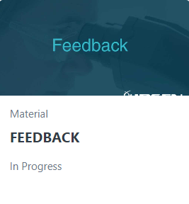
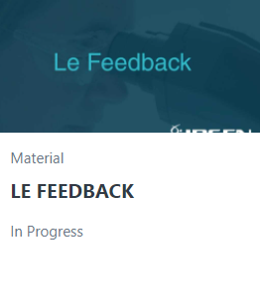
Feedback playlists in iLearn
English
French
German
Italian
Spanish
Chinese
eLearning & videos on how to give, receive and ask effective feedback
Click to access

Slide 19
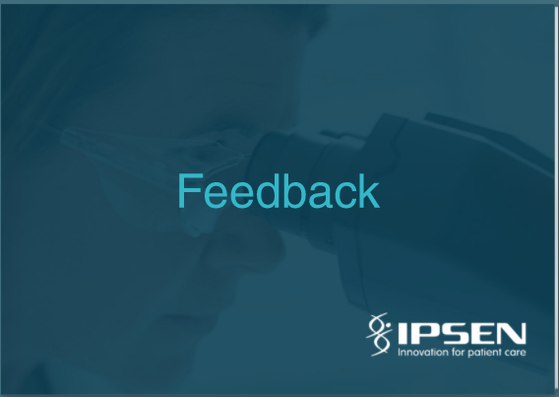
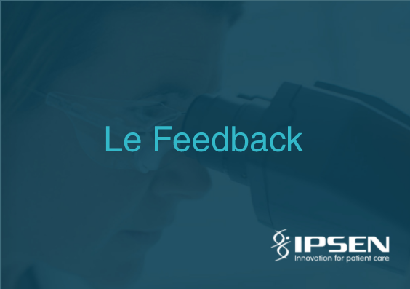
Feedback fluidbooks
Revamped content – Available in English & French
Click to access
Click to access

Slide 20

360 tool feedback
Automated internal 360 feedback: GLT members but also all relevant employees or teams
360 tool based on same platform as Engagement tool
Wide bank of questions + possibility to create Ipsen own questions.
Automated reports & analysis with powerful IA to provide broad analysis including analysis of verbatims/comments & dashboards.
Automated action plan for individual at the end of each report with access of some embedded short learning content (as part of the tool) but also possibility to add our own content (iLearn…)
Cross analysis possible with results of Engagement survey (for instance for a division, for a management level etc.)
Unlimited number of 360 (possibility to extend to division LT, specific 360 for high po / top talent…)

Slide 21
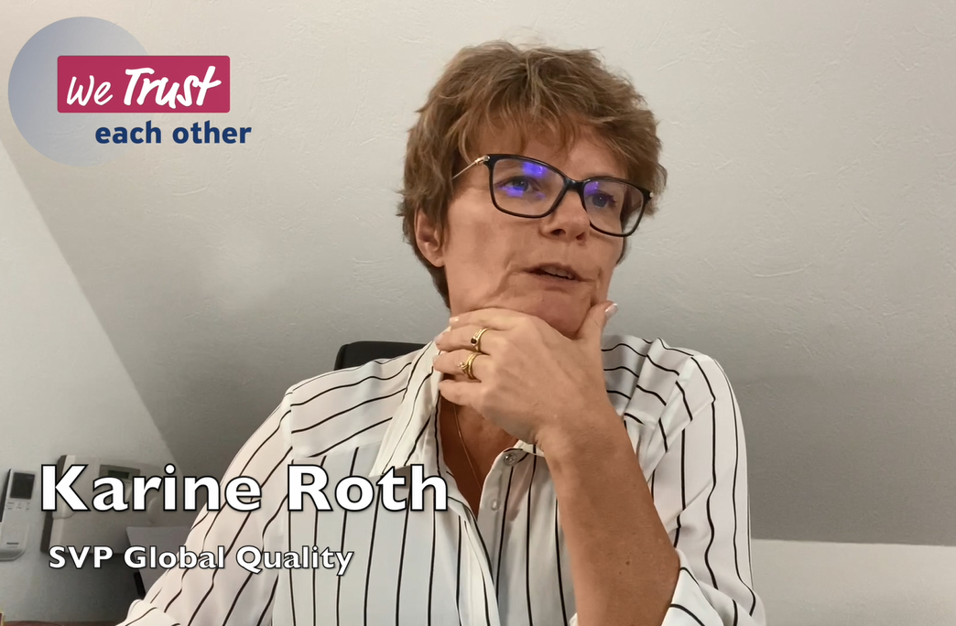
Video about Continuous Feedback at Ipsen
A powerful message about feedback
https://ipsenpharma.ent.box.com/file/782166118010?s=c2zloq1wbj8fvae7a3dw7mz7mycpokkq

Slide 22

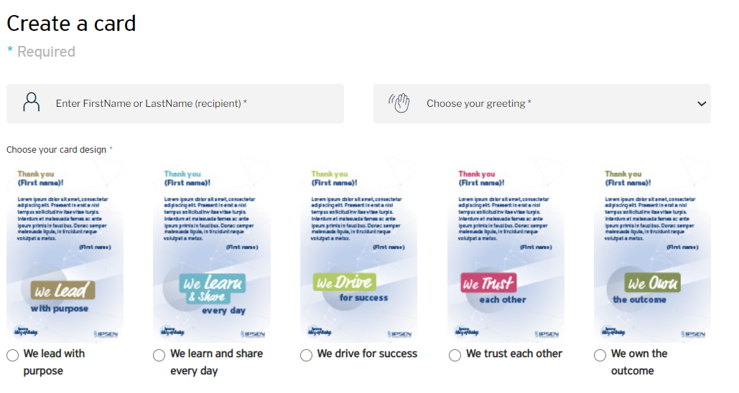
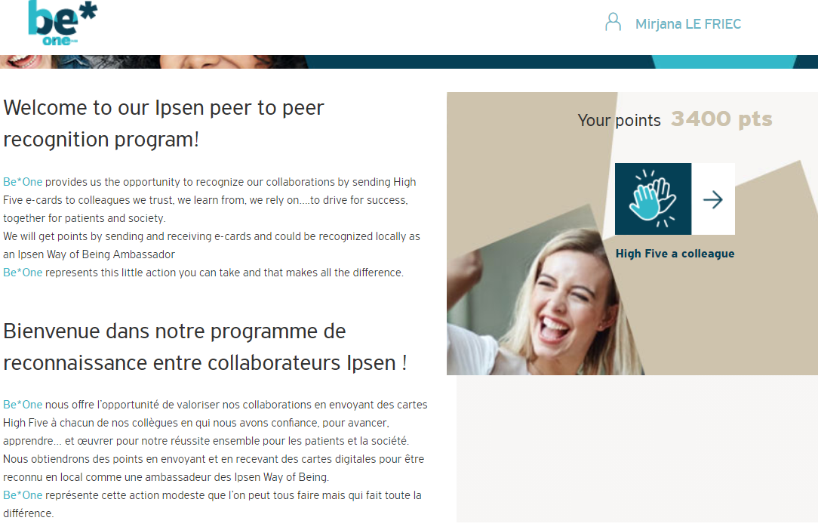
Be*One
Ipsen peer-to-peer recognition tool
https://beone.ipsen.com/

Slide 23
Feedback guide
Giving and receiving feedback
Feedback culture & Ipsen Way of Being
Type of feedbacks
How to give feedback
How to receive feedback
When to ask for feedback
Available feedback tools
And much more…

Slide 24
Feedback: interactive training & awareness sessions
Coming soon
Roleplays Workshops on giving and receiving feedback (F2F & virtual mode)
Game learning to master feedback (individual experience)
Teams’ icebreakers (remote & F2F)

Slide 25
Thank
You

